Slide 1
Muscle system

Slide 3
Muscle Tissue
The muscular tissue consists of all the muscles of the body. These make up almost 42% of total body weight, and are composed of long cells known as fibers. The fibers are different lengths and vary in color from white to deep red. These cells have the special ability to shorten or contract in order to produce movement of the body parts , The cells are usually arranged in bundles or layers that are surrounded by connective tissue. Actin and myosin are contractile proteins in muscle tissue. Muscle tissue can be classified classified according to function and appearance into : skeletal muscle tissue, smooth muscle tissue, and cardiac muscle tissue.

Slide 5
Skeletal muscle
Skeletal muscle fibers are long cylindrical, multinucleated cells, with peripherally placed nuclei , striated, contraction is typically quick and strong and under voluntary control , skeletal muscle tissue is closely attached to skeletal bones.

Slide 6
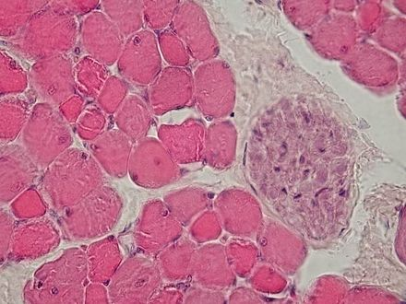
Functions of Skeletal Muscle
Body movement.
Maintenance of posture.
Protection and support.
Heat production.

Slide 7
Smooth muscle
Smooth muscle cells are spindle shaped, have a single, centrally located nucleus, and lack striations. They are called involuntary muscles. The wall of internal organs such as the blood vessels, stomach and intestine contain this type of muscle tissue.

Slide 8
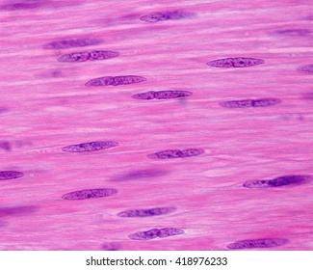
Smooth muscle

Slide 9
Cardiac muscle
Cardiac muscle has branching fibers, one nucleus per cell, striations. Its contraction is not under voluntary control. Cardiac muscle are striated like skeletal muscles, but they are smaller and shorter. Cardiac muscle tissue is a contractile tissue present only in the heart. Cell junctions fuse the plasma membranes of cardiac muscle cells and make them stick together. Communication junctions (intercalated discs) at some fusion points allow the cells to contract as a unit. Cardiac muscle pump blood continuously.

Slide 10
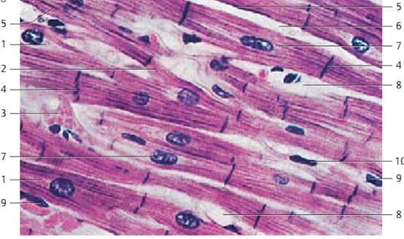
Cardiac muscle

Slide 11
Comparison of the three types of muscle cells

